Slide 1
WIA1005 Network Technology Foundation
Chapter 10
DHCP

Slide 2
Contents
DHCPv4
DHCPv4 Configuration
DHCPv6
DHCP Attack

Slide 3
DHCPv4
Dynamic Host Configuration Protocol (DHCPv4) assigns IPv4 addresses and other network configuration information dynamically.
Automatic Allocation - DHCPv4 automatically assigns a static IPv4 address permanently to a device, selecting it from a pool of available addresses. There is no lease and the address is permanently assigned to the device.
Dynamic Allocation - DHCPv4 dynamically assigns, or leases, an IPv4 address from a pool of addresses for a limited period of time chosen by the server, or until the client no longer needs the address.

Slide 4
DHCPv4
DHCP Discover
  The DHCPDISCOVER message finds DHCPv4 servers on the network. It uses Layer 2 and Layer 3 broadcast addresses to communicate with the server.
DHCP Offer
  When the DHCPv4 server receives a DHCPDISCOVER message, it reserves an available IPv4 address to lease to the client.
  The DHCPOFFER message is sent as a unicast, using the Layer 2 MAC address of the server as the source address and the Layer 2 MAC address of the client as the destination.

Slide 5
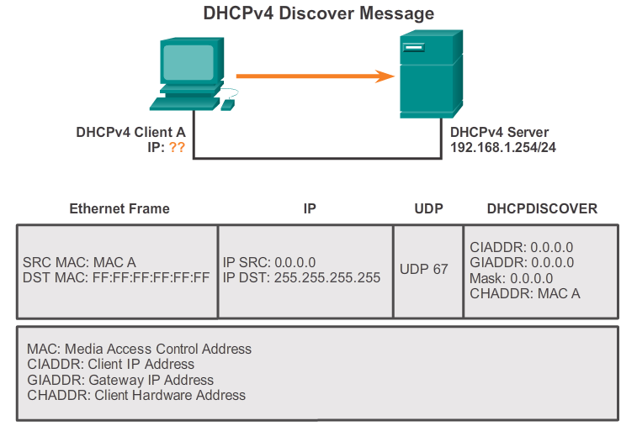
DHCPv4

Slide 6
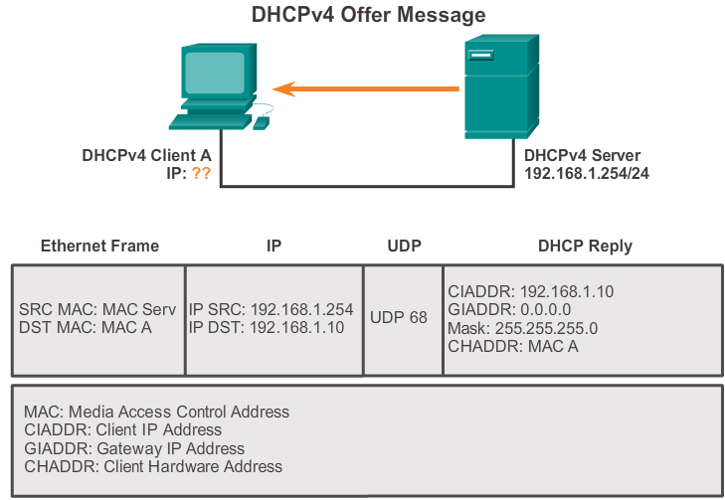
DHCPv4

Slide 7
DHCPv4
DHCP Request (DHCPREQUEST)
  When the client receives the DHCPOFFER from the server, it sends back a DHCPREQUEST message. The DHCPREQUEST serves as a binding acceptance notice to the selected server for the parameters it has offered and an implicit decline to any other servers that may have provided the client a binding offer.
  The DHCPREQUEST message is sent in the form of a broadcast to inform this DHCPv4 server and any other DHCPv4 servers about the accepted offer.

Slide 8
DHCPv4
DHCP Acknowledgment (DHCPACK)
  On receiving the DHCPREQUEST message, the server verifies the lease information with an ICMP ping to that address to ensure it is not being used already, creates a new ARP entry for the client lease, and replies with a unicast DHCPACK message.
  When the client receives the DHCPACK message, it logs the configuration information and performs an ARP lookup for the assigned address. If there is no reply to the ARP, the client knows that the IPv4 address is valid and starts using it as its own.

Slide 9
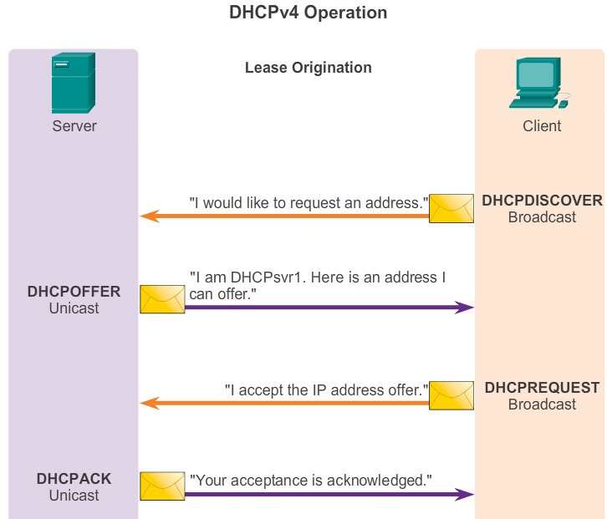
DHCPv4

Slide 10
DHCPv4
Lease Renewal
  When the lease has expired, the client sends a DHCPREQUEST message directly to the DHCPv4 server that originally offered the IPv4 address.
  If a DHCPACK is not received within a specified amount of time, the client broadcasts another DHCPREQUEST so that one of the other DHCPv4 servers can extend the lease.
  On receiving the DHCPREQUEST message, the server verifies the lease information by returning a DHCPACK.

Slide 11
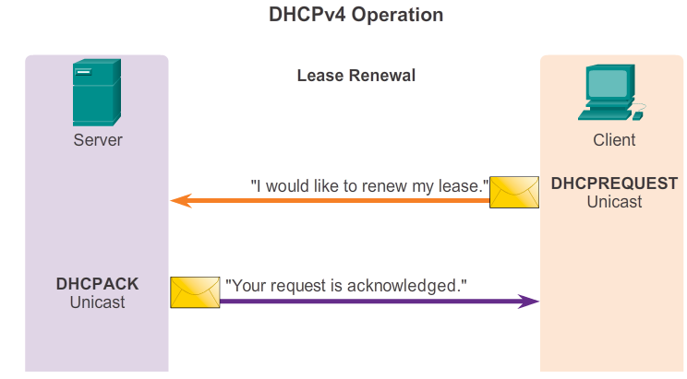
DHCPv4

Slide 12
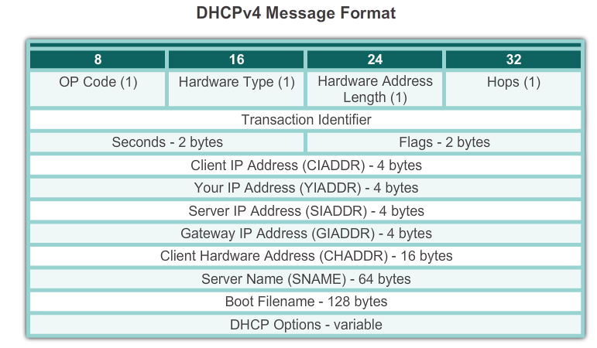
DHCPv4
DHCPv4 messages are encapsulated within the UDP transport protocol.
DHCPv4 messages sent from the client use UDP source port 68 and destination port 67.

Slide 13
DHCPv4 Configuration
A router can be configured to act as a DHCPv4 server.
Step 1. Excluding IPv4 Addresses
  Typically, some IPv4 addresses in a pool are assigned to network devices that require static address assignments.
  Therefore, these IPv4 addresses should not be assigned to other devices.
Step 2. Configuring a DHCPv4 Pool
  Configuring a DHCPv4 server involves defining a pool of addresses to assign.

Slide 14
DHCPv4 Configuration
Step 3. Configuring Specific Tasks
  The tasks include the address pool and the gateway as well as some optional tasks such dns server, domain name and lease time. The default lease time is one day.
The DHCPv4 service is enabled, by default. To disable the service, use the no service dhcp command. Use the service dhcp command to re-enable the DHCPv4 service.
The show running-config | section dhcp command displays the DHCPv4 commands configured on a router.

Slide 15
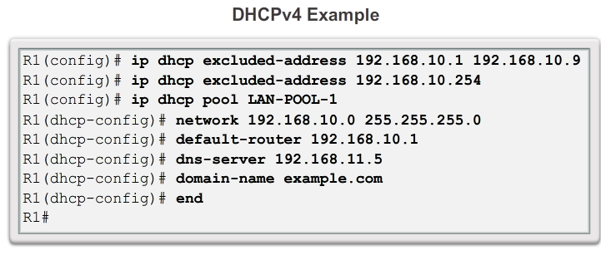
DHCPv4 Configuration

Slide 16
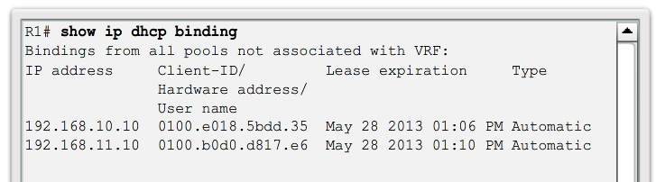
DHCPv4 Configuration

Slide 17
DHCPv4 Configuration
DHCP Relay
  In a complex hierarchical network, network clients are not typically on the same subnet as DHCP servers. In order to locate the servers and receive services, clients often use broadcast messages.
  DHCPv4 relay is a process to enable a router to forward DHCPv4 broadcasts to the DHCPv4 server.
  The ip helper-address command can be configured on the interface that receive the broadcast messages.

Slide 18
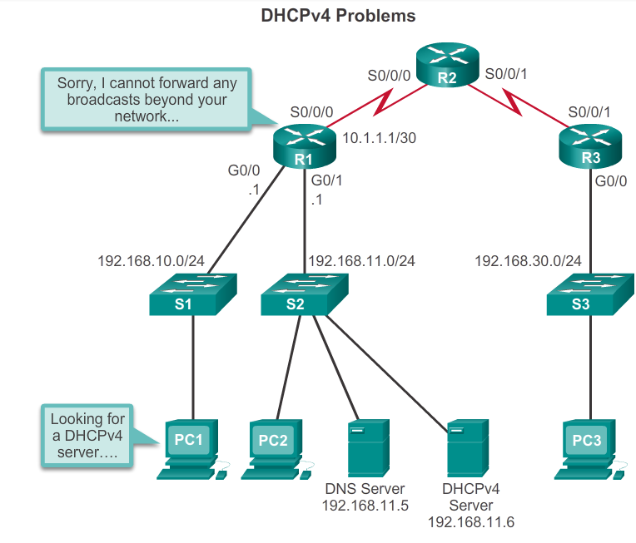
DHCPv4 Configuration

Slide 19
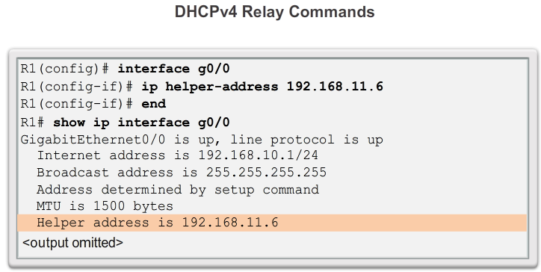
DHCPv4 Configuration

Slide 20
DHCPv4 Configuration
By default, the ip helper-address command forwards the following eight UDP services:
  Port 37: Time
  Port 49: TACACS
  Port 53: DNS
  Port 67: DHCP/BOOTP client
  Port 68: DHCP/BOOTP server
  Port 69: TFTP
  Port 137: NetBIOS name service
  Port 138: NetBIOS datagram service

Slide 21
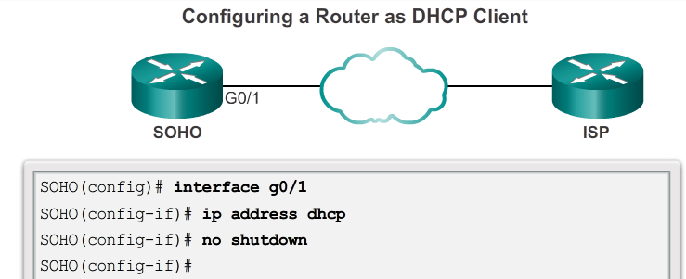
DHCPv4 Configuration

Slide 22
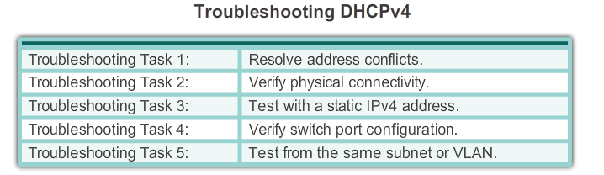
DHCPv4 Configuration

Slide 23
DHCPv6
IPv6 global unicast addresses can be assigned dynamically:
  Stateless Address Autoconfiguration (SLAAC) (A flag)
  Dynamic Host Configuration Protocol for IPv6 (Stateful DHCPv6)
ICMPv6 RA messages contain the Managed Address Configuration flag (M flag) and the Other Configuration flag (O flag) to determine how the client obtain its IPv6 addressing
To set the flag, use ipv6 nd other-config-flag command and ipv6 nd managed-config-flag command.

Slide 24
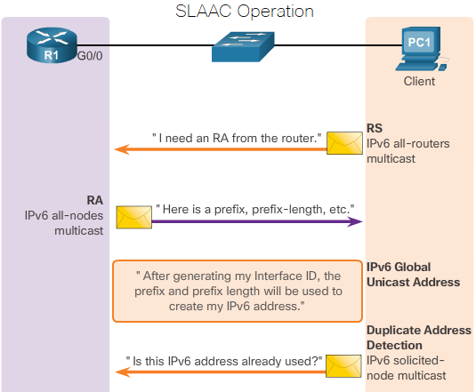
DHCPv6

Slide 25
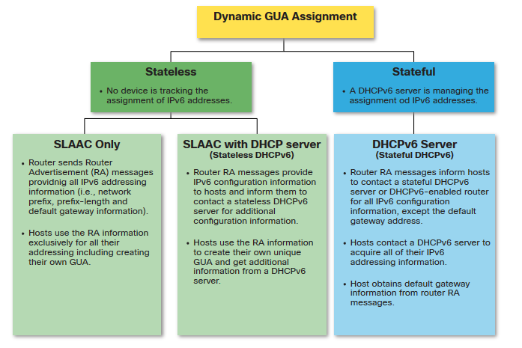
DHCPv6

Slide 26
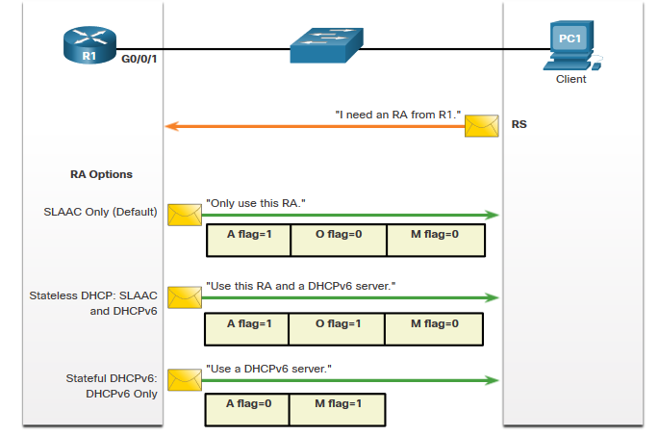
DHCPv6

Slide 27
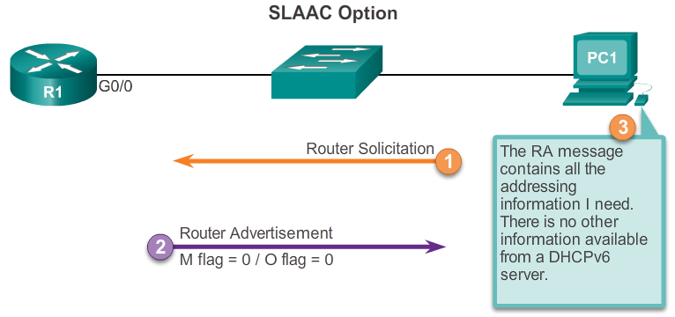
DHCPv6

Slide 28
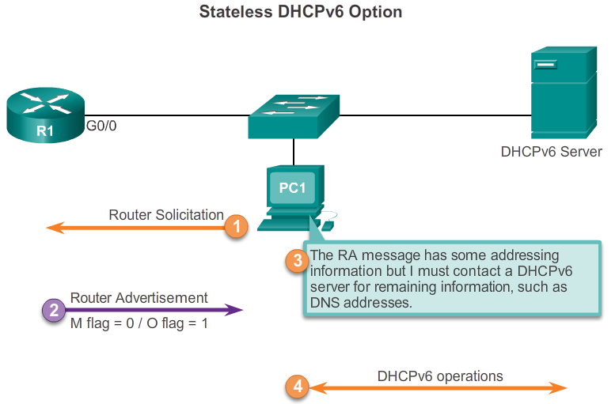
DHCPv6

Slide 29
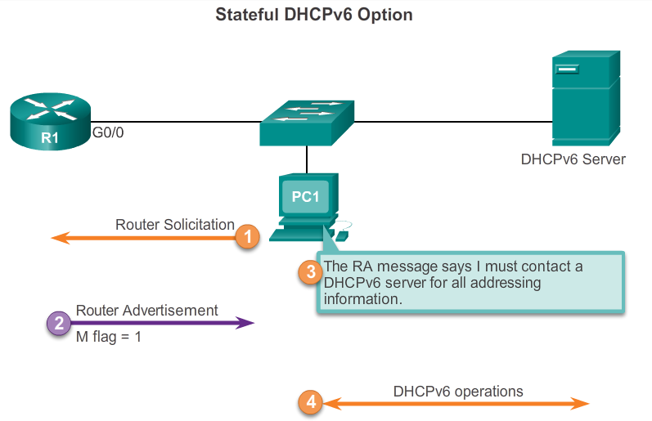
DHCPv6

Slide 30
DHCPv6
DHCPv6 messages are sent over UDP. DHCPv6 messages from the server to the client use UDP destination port 546. The client sends DHCPv6 messages to the server using UDP destination port 547.
First, the client sends a DHCPv6 SOLICIT message to the reserved IPv6 multicast all-DHCPv6-servers address FF02::1:2. This multicast address has link-local scope, which means routers do not forward the messages to other networks.
One or more DHCPv6 servers respond with a DHCPv6 ADVERTISE message. The ADVERTISE message informs the DHCPv6 client that the server is available for DHCPv6 service.

Slide 31
DHCPv6
The Stateless DHCPv6 client responds with a DHCPv6 INFORMATION-REQUEST message to the DHCPv6 server requesting only configuration parameters, such as DNS server address.
The Stateful DHCPv6 client responds with a DHCPv6 REQUEST message to the server to obtain an IPv6 address and all other configuration parameters from the server.
The server sends a DHCPv6 REPLY to the client containing the information requested.

Slide 32
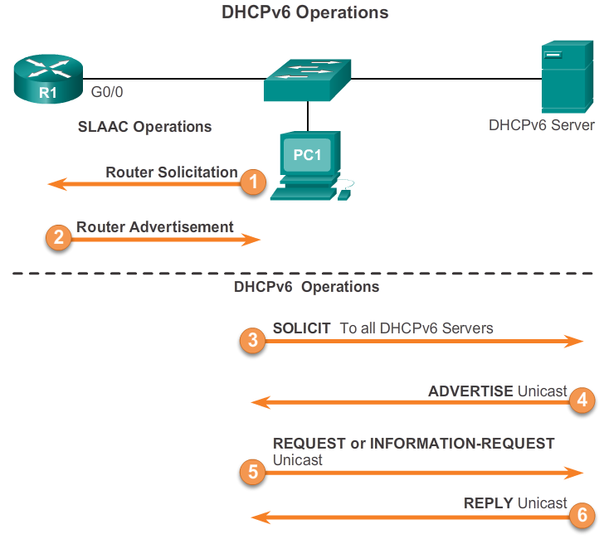
DHCPv6

Slide 33
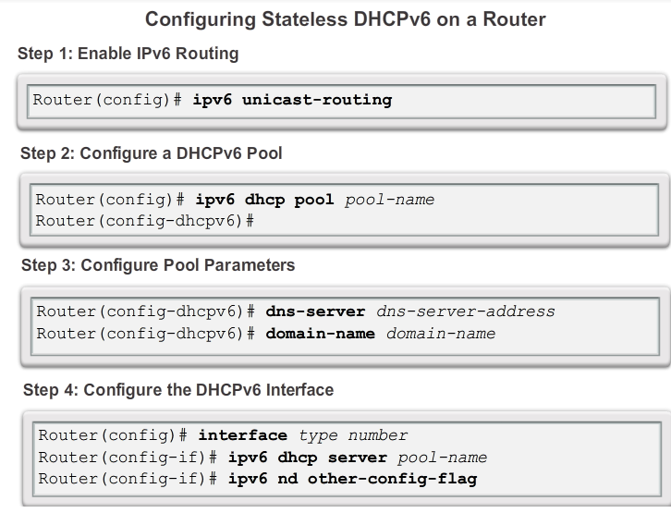
DHCPv6 Configuration

Slide 34
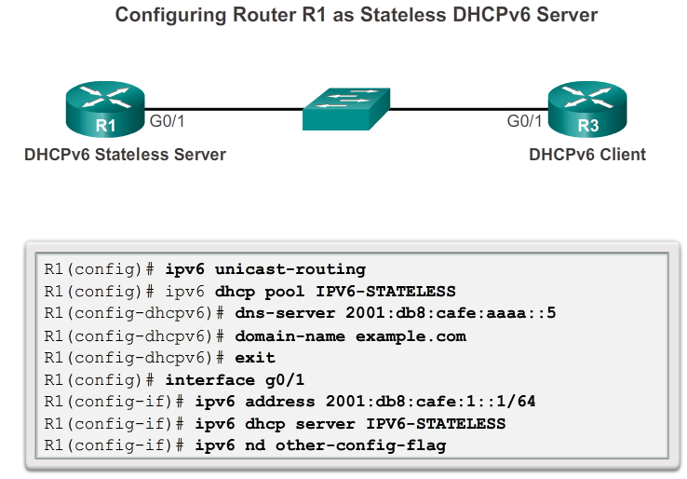
DHCPv6 Configuration

Slide 35
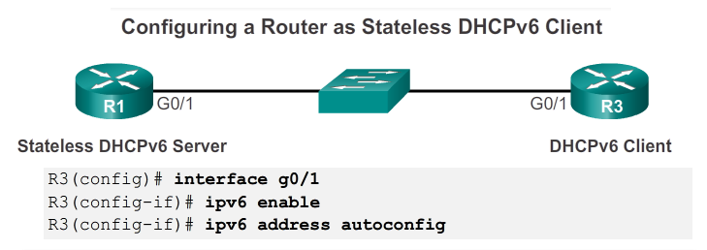
DHCPv6 Configuration

Slide 36
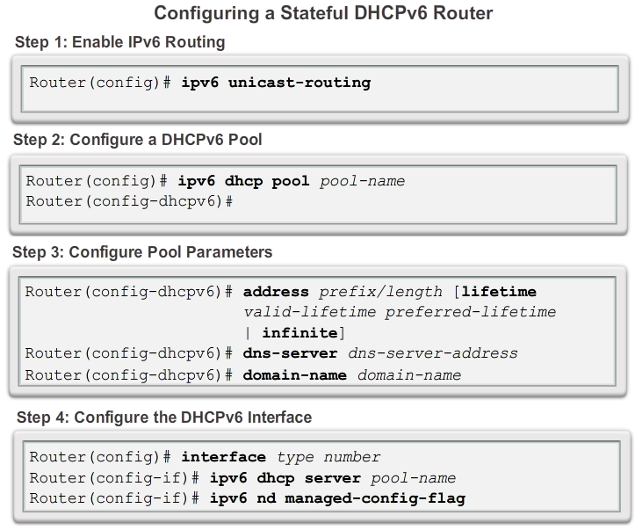
DHCPv6 Configuration

Slide 37
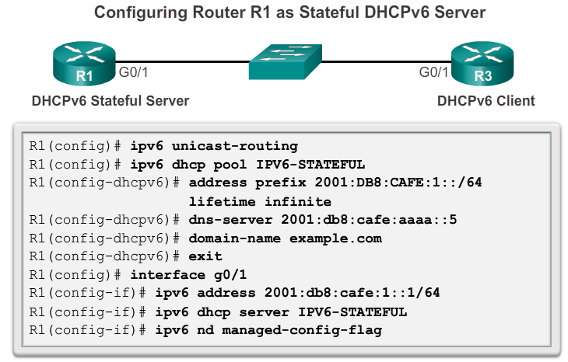
DHCPv6 Configuration

Slide 38
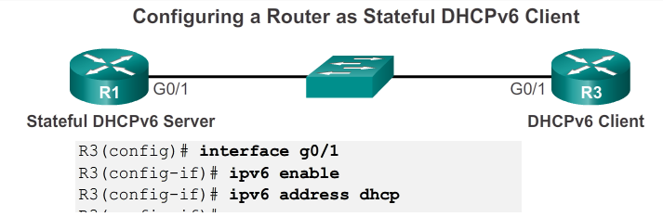
DHCPv6 Configuration

Slide 39
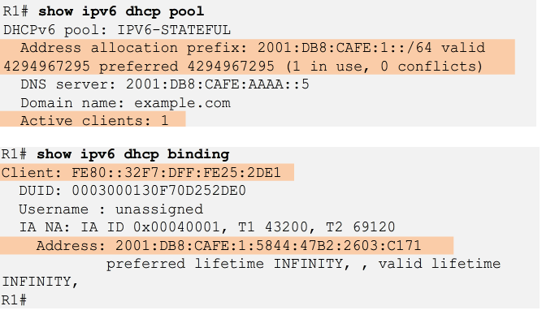
DHCPv6 Configuration

Slide 40
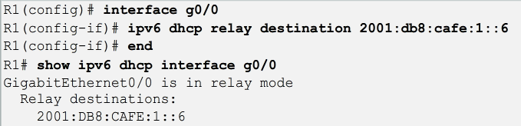
DHCPv6
If the DHCPv6 server is located on a different network than the client, then the IPv6 router can be configured as a DHCPv6 relay agent.
A DHCPv6 relay agent is configured using the ipv6 dhcp relay destination command. This command is configured on the interface facing the DHCPv6 client using the address of the DHCPv6 server as the destination.

Slide 41
DHCP Attack
DHCP starvation attacks
  An attacker floods the DHCP server with DHCP requests to use up all the available IP addresses that the DHCP server can issue. (Gobbler)
  After these IP addresses are issued, the server cannot issue any more addresses, and this situation produces a denial-of-service (DoS) attack as new clients cannot obtain network access.
DHCP spoofing attacks
  An attacker configures a fake DHCP server on the network to issue DHCP addresses to clients.
  The attack is to force the clients to use machine under the control of the attacker, as their default gateway.

Slide 42
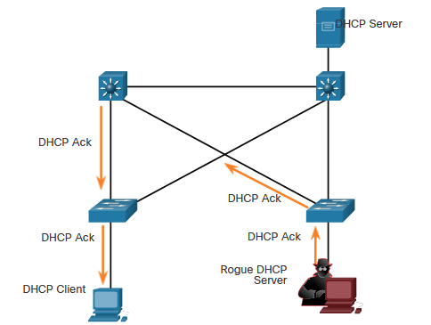
DHCP Attack

Slide 43
DHCP Attack
DHCP Snooping
  DHCP snooping determines whether DHCP messages are from an administratively configured trusted or untrusted source.
  Devices under your administrative control, such as switches, routers, and servers, are trusted sources.
  In addition, all access ports are generally treated as untrusted sources.
  Trusted ports can source all DHCP messages; untrusted ports can source requests only.

Slide 44
DHCP Attack
  All interfaces are treated as untrusted by default. Trusted interfaces are typically trunk links and ports directly connected to a legitimate DHCP server.
  If a rogue device on an untrusted port attempts to send a DHCP response packet into the network, the port is shut down.
  A DHCP table is built that includes the source MAC address of a device on an untrusted port and the IP address assigned by the DHCP server to that device.
  The MAC address and IP address are bound together. Therefore, this table is called the DHCP snooping binding table.

Slide 45
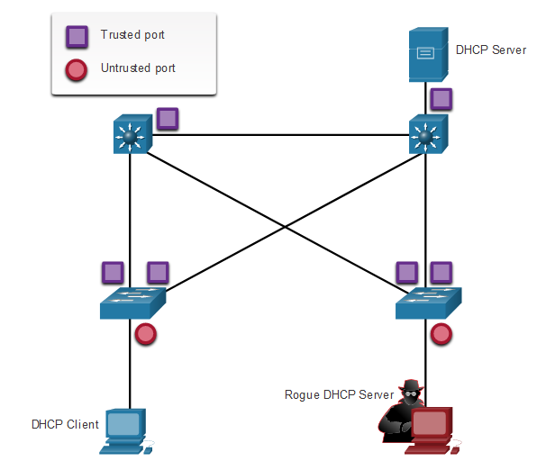
DHCP Attack

Slide 46
DHCP Attack
Step 1. Enable DHCP snooping by using the ip dhcp snooping
Step 2. On trusted ports, use the ip dhcp snooping trust
Step 3: Limit the number of DHCP discovery messages that can be received per second on untrusted ports by using the ip dhcp snooping limit rate. The rate limit is set to number of packets per second.

Slide 47
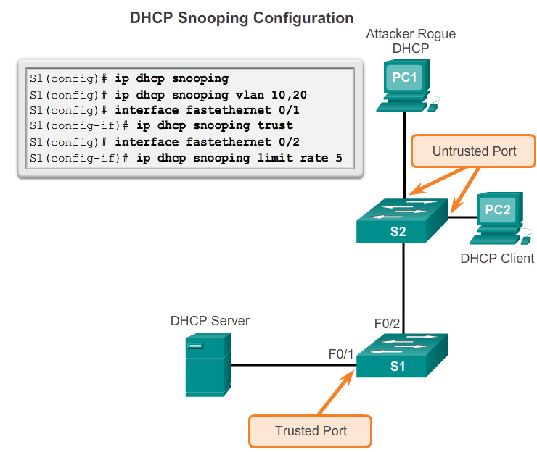
DHCP Attack

